Slide 1
Functional Dependency (FD) is a constraint that determines the relation of one attribute to another attribute in a Database Management System (DBMS).
DATABASE NORMALIZATION
KEYWORDS
FUNCTIONAL DEPENDENCY
A functional dependency is denoted by an arrow "→". The functional dependency of X on Y is represented by X → Y.
The left side of FD is known as a determinant, the right side of the production is known as a dependent.

Slide 2
FUNCTIONAL DEPENDENCY
Employee ID | Employee Name | Salary | City
111 | Anji | 50000 | San Francisco
222 | Priyanka | 38000 | London
333 | Ajay | 25000 | Tokyo
Employee ID → Employee Name
Employee ID → Salary
Employee ID → City

Slide 3
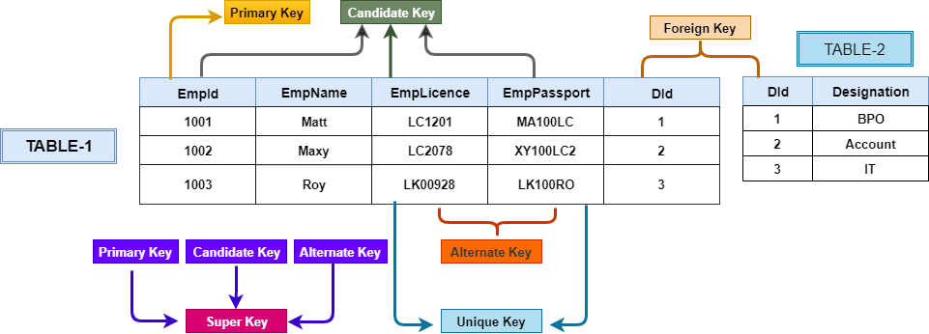
A primary key having two or more attributes is called composite key. It is a combination of two or more columns
COMPOSITE KEY
Sometimes more than one attributes are needed to uniquely identify an entity. A primary key that is made by the combination of more than one attribute is known as a composite key.
CANDIDATE KEY

Slide 4
A non-prime attribute is functionally dependent on a part of composite primary key.
PARTIAL DEPENDENCY
Emp_ID | Emp_Name | App_ID | App_Name
11 | Aarya | 5555 | SS
22 | Narayana | 6666 | CPS
11 | Aarya | 7777 | GPS
33 | Anji | 8888 | Acess
44 | Murthy | 7777 | GPS
55 | Ajay | 5555 | SS
33 | Anji | 9999 | SVOD
Emp_ID & App_ID → composite primary key
Emp_Name & App_Name → non-prime attributes
Emp_ID → Emp_Name
App_ID → App_Name

Slide 5
A transitive dependency in a database is an indirect relationship between values in the same table that causes a functional dependency.
TRANSITIVE DEPENDENCY
A transitive dependency is a type of functional dependency which happens when it is indirectly formed by two functional dependencies
EMP_ID | EMP_NAME | EMP_ZIP | EMP_STATE | EMP_CITY
111 | Aarya | 523001 | AP | Ongole
222 | Anji | 500032 | TS | Hyderabad
333 | Priyanka | 534204 | AP | Bhimavaram
444 | Sonu | 524001 | AP | Nellore
EMP_ID → EMP_ZIP
EMP_ZIP → EMP_STATE , EMP_CITY
EMP_ID → EMP_STATE, EMP_CITY

Slide 6
A → B, for a single value of A multiple values of B exits.
MULTI-VALUED DEPENDENCY
Table should have atleast 3 columns.
For a relation (A, B, C), if there is multivalued dependency A → B, then B and C should be independent of each other.
STU_ID | COURSE | HOBBY
21 | Computer | Dancing
21 | Math | Singing
34 | Chemistry | Dancing
74 | Biology | Cricket
74 | Physics | Cricket
STU_ID → COURSE, for a single value of STU_ID multiple values of COURSE exists
For a relation (STU_ID, COURSE, HOBBY), COURSE and HOBBY are independent to each other.

Slide 7
Decomposition is lossless if it is feasible to reconstruct relation R from decomposed tables using Joins.
LOSSLESS JOIN DEPENDENCY or LOSSLESS DECOMPOSITION
The relation is said to be lossless decomposition if natural joins of all the decomposition give the original relation.
<EmpInfo>
Emp_ID | Emp_Name | Emp_Age | Emp_Location | Dept_ID | Dept_Name
E001 | Jacob | 29 | Alabama | Dpt1 | Operations
E002 | Henry | 32 | Alabama | Dpt2 | HR
E003 | Tom | 22 | Texas | Dpt3 | Finance
<EmpDetails>
Emp_ID | Emp_Name | Emp_Age | Emp_Location
E001 | Jacob | 29 | Alabama
E002 | Henry | 32 | Alabama
E003 | Tom | 22 | Texas
EmpInfo
EmpInfo
EmpDetails
DeptDetails
<DeptDetails>
Dept_ID | Emp_ID | Dept_Name
Dpt1 | E001 | Operations
Dpt2 | E002 | HR
Dpt3 | E003 | Finance

Slide 8
The term domain refers to the current set of values found under an attribute name
DOMAIN CONSTRAINTS
Domain constraints can be defined as the definition of a valid set of values for an attribute
The data type of domain includes string, character, integer, time, date, currency, etc. The value of the attribute must be available in the corresponding domain.
KEY CONSTRAINTS
Keys are the entity set that is used to identify an entity within its entity set uniquely. An entity set can have multiple keys, but out of which one key will be the primary key.
We have 5 types of key constraints in DBMS
NOT NULL: ensures that the specified column doesn’t contain a NULL value.
UNIQUE : provides a unique/distinct values to specified columns.
DEFAULT: provides a default value to a column if none is specified.
CHECK :checks for the predefined conditions before inserting the data inside the table.
PRIMARY KEY: it uniquely identifies a row in a table.
FOREIGN KEY: ensures referential integrity of the relationship

Slide 9
UNF
NoSQL databases are based on the principles of the unnormalized relational model
1NF
All entries must be single-valued and atomic
2NF
It should be in 1NF
3NF
BCNF
4NF
5NF
DKNF
Every column must be unique in each table.
No partial dependency
It should be in 2NF
No transitive dependency
Advanced version of 3NF or 3.5NF
Every functional dependency X → Y, X is the super key
It should be in BCNF
No multi-valued dependency
It should be in 4NF and no join dependency
Joining two or more decomposed table should not lose records nor create new records.
Domain-Key Normal Form is the highest form of Normalization.
Logical sequence of the domain constraints and key constraints applied to the relation.

